Slide 1


CLOUDLET
CARETAKER
AGENT
THE NEXT EVOLUTION OF INTELLIGENT AUTOMATION

Slide 2

CLOUDLET
“AI THAT ACTS, LEARNS, AND DECIDES IS NO LONGER SCIENCE FICTION.”

Slide 3

CLOUDLET
PROBLEM STATEMENT
Modern professionals are paralyzed by context switching. We bounce constantly between IDEs, Slack, Outlook, and dashboards. This creates three critical bottlenecks:
The Context Tax: Wasting time digging for documents and links immediately after a meeting ends.
Forgotten Commitments: Promises made on calls are instantly forgotten when returning to deep work.
Mental Paralysis: When overwhelmed, massive to-do lists cause anxiety, not action.
The Solution: A Zero-Cognitive-Load Assistant :
Caretaker AI is not another dashboard you have to manage. It is a local, context-aware agent that manages you. It passively tracks your commitments, understands your active workflow, and spoon-feeds you exactly one task or document at the exact moment you need it.

Slide 4
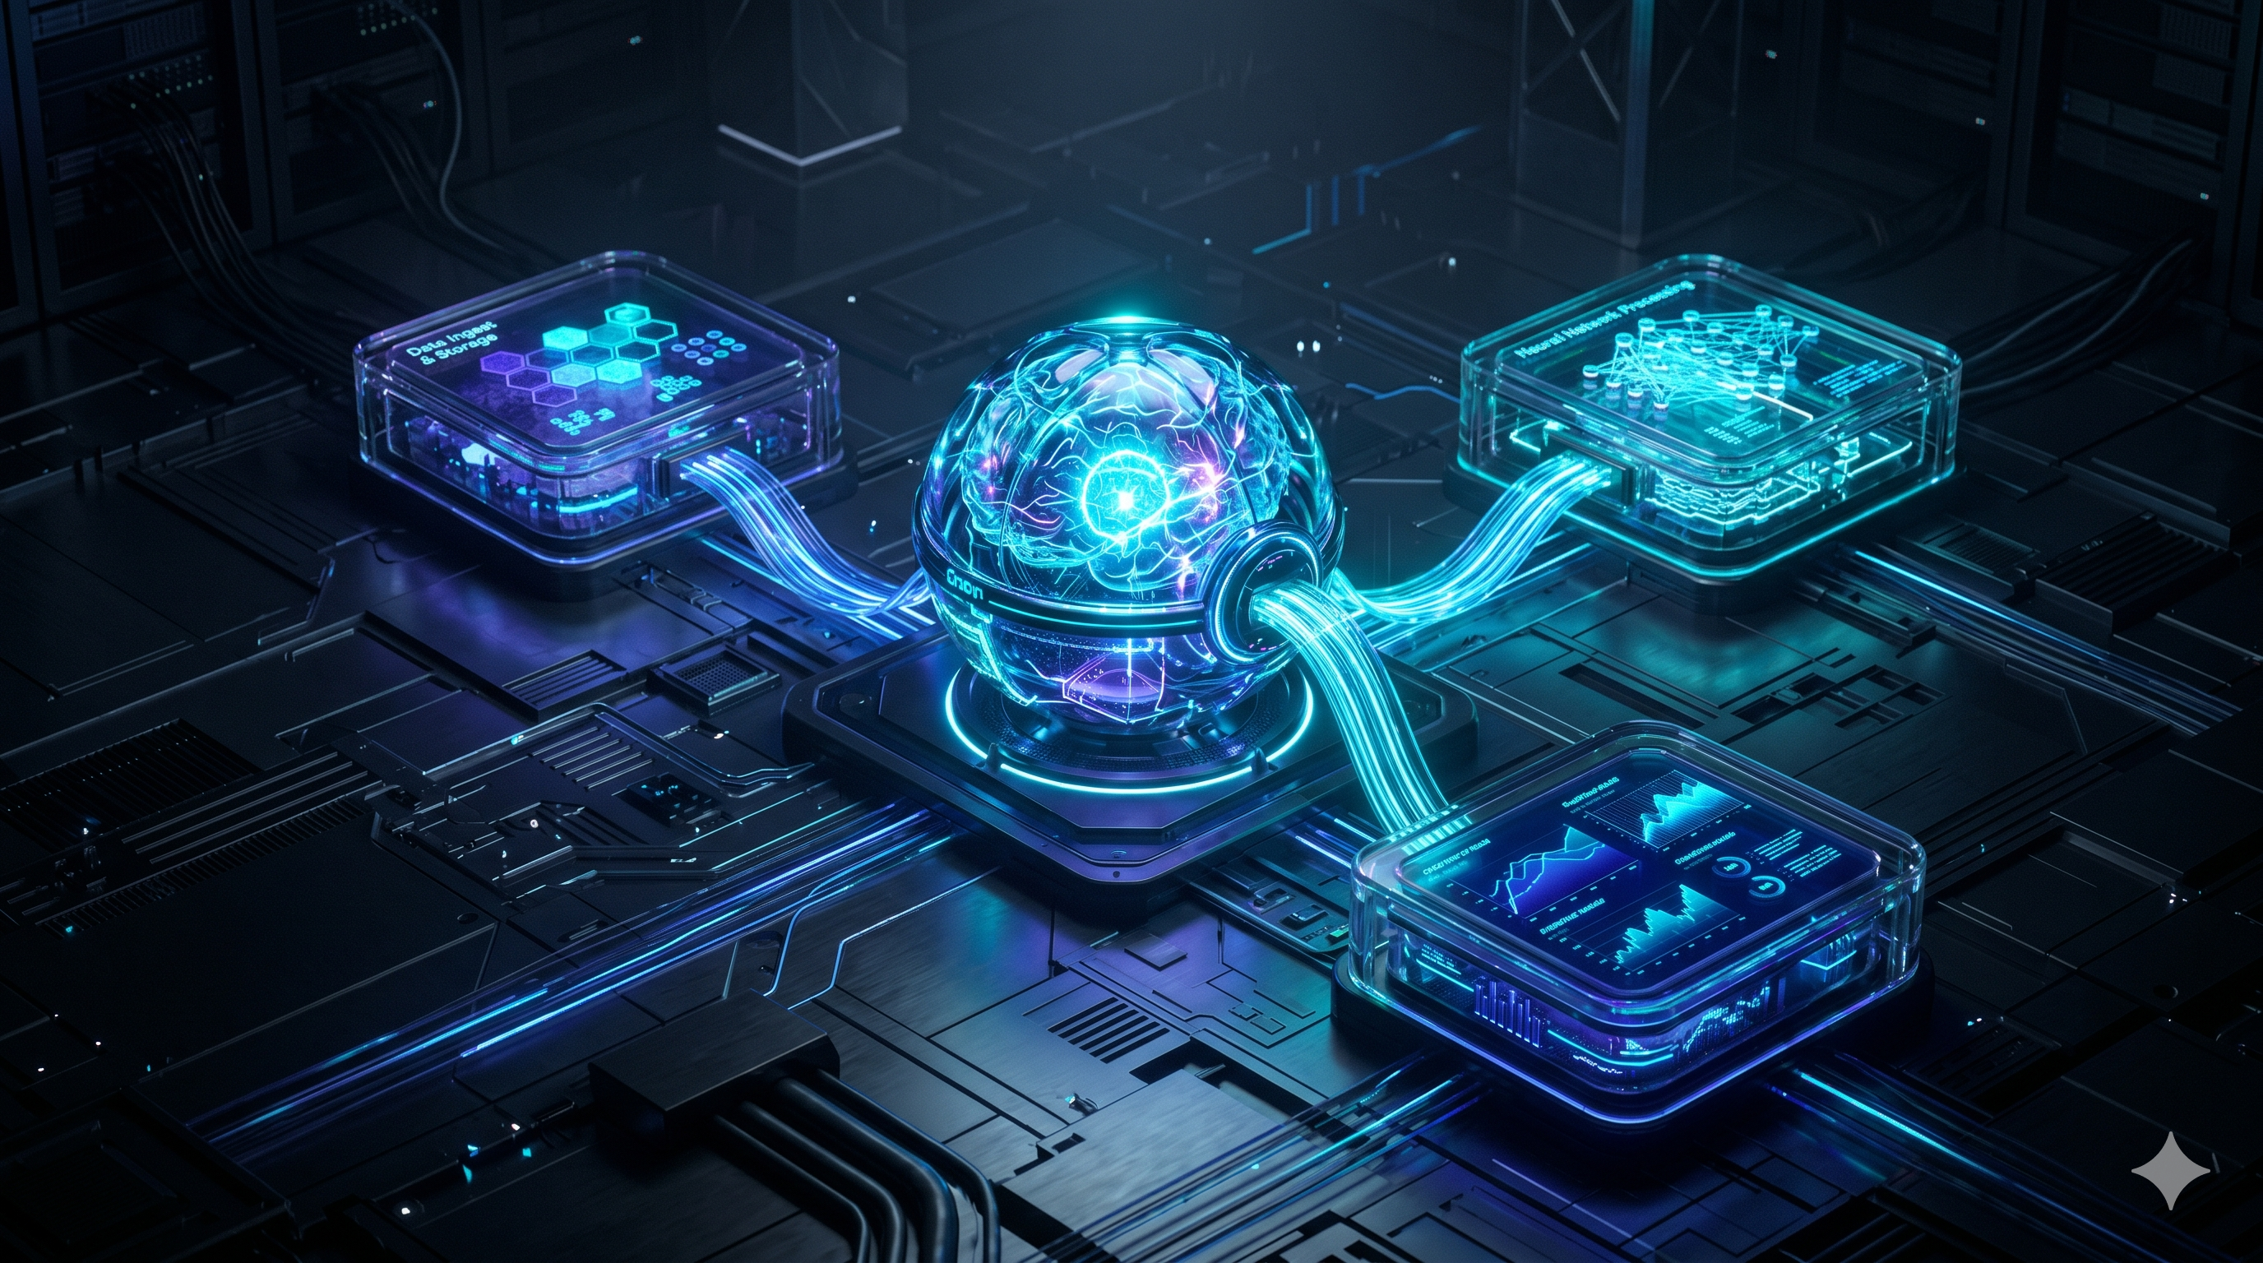
AI Architecture & Tech Stack
1. The Core Infrastructure
Python: The foundational language currently driving local automation, system monitoring, and AI workflows.
FastAPI: Provides high-performance, low-latency APIs connecting all active system components.
PostgreSQL: The central state machine securely storing tasks, activity history, and user memories.
Microsoft Graph API: The integration layer connecting the agent directly to Microsoft Teams, Outlook, and Calendar to seamlessly extract meeting context and commitments.
2. The 4-Layer Modular Architecture
Context Layer: A local Python daemon monitoring OS activity (VS Code, Teams) to map focus patterns.
Memory System: Securely archives "Panic Dumps," commitments, and notes.
Brain Layer: The central intelligence hub aggregating active context to understand user intent.
Agent Layer: The execution layer that transforms the Brain’s reasoning into actionable outputs.

Slide 5
Learnings and exploration
3. R&D & Architectural Roadmap
Agentic Frameworks: Actively exploring Addy Osmani’s repositories and Microsoft's AI open-source projects as technical references for our planned hierarchical agent implementation.
System Telemetry: Successfully architected the local OS daemon using Google technical documentation as a guide.
Applied Orchestration: Using CampusX engineering content to design the upcoming transition from rule-based logic to dynamic agent loops.

Slide 6

Examples
1. The "Panic Dump" (Unstructured to Structured)
The User Does: Types a messy, stressed note: "Meeting with Aditya went long, need to fix the auth_router bug before Friday and ping Sarah for the API keys."
The Agent Does: Instantly parses the intent. It logs a high-priority bug fix for auth_router, schedules a reminder for Thursday, and automatically drafts a Teams message to Sarah asking for the keys.
2. The Meeting Handoff (Microsoft Graph Integration)
The User Does: Drops off a 45-minute Microsoft Teams call and immediately switches back to coding in VS Code.
The Agent Does: Detects the calendar event ended. It quietly pulls the meeting transcript, extracts the action items you promised, and queues them in your task list without interrupting your coding session.

Slide 7
Current Progress & Key Decisions
1. What We Have Built (Progress)
Active Window Tracking: The app successfully tracks active windows and calculates focus time.
Task & Memory Systems: The database can store tasks, save user notes, and block duplicate entries.
The "Panic Dump": Users can type messy, unstructured thoughts, and the system cleanly captures it for processing.
2. Key Design Decisions
Strictly Modular: The backend is clearly split into 5 distinct services: Task, Memory, Brain, Agent, and Context.
Central "Brain": Individual modules aren't allowed to make decisions. All data flows into the central Brain so the AI has the full picture.
Event-Driven: We treat everyday user actions (like switching tabs) as signals to trigger the AI's logic.

Slide 8


challenges
Current Challenges (The Hard Parts)
Understanding Intent: Knowing the user opened VS Code is easy. Knowing if they are actively debugging or just reading documentation is the hard part.
Reducing Noise: The assistant needs to be genuinely helpful without becoming just another annoying pop-up notification.
Ensuring Privacy: Because we track OS activity, we are strictly building this as a local-first system to keep company data secure.

Slide 9

System Scalability
CLOUDLET
Asynchronous Telemetry Ingestion: The background daemon generates massive amounts of noisy OS data. Instead of blocking the FastAPI server, we route incoming telemetry through message queues (e.g., Redis/Celery). FastAPI instantly returns a 200 OK, while background workers process the data, ensuring zero latency for the user.
Database & Vector Scaling: As user memories and tasks grow, basic queries fail. We scale PostgreSQL using connection pooling (PgBouncer) and table partitioning for historical telemetry. For the pgvector extension, we implement HNSW (Hierarchical Navigable Small World) indexing to guarantee semantic searches execute in under 50ms, even with millions of memory embeddings.
High-Concurrency LLM Serving: Running local models per user is hardware-impossible at scale. The Llama model sits on a centralized internal VPC. We scale inference using frameworks like vLLM with continuous batching, allowing a single internal GPU cluster to serve dozens of concurrent agent requests efficiently without bottlenecking.

Slide 10
Enterprise Security & Readiness
Role-Based Access (RBAC): The AI dynamically respects corporate hierarchy, ensuring it only retrieves and summarizes files that the user is already explicitly authorized to view.
Strict Data Isolation: Enterprise data is securely walled off in isolated database vaults, guaranteeing that private meeting notes and calendars never cross over between different teams or clients.
Immutable Audit Logs: Every automated action the assistant takes—like drafting an email or logging a task—is permanently recorded, giving IT a fully transparent history of the AI's decisions.

Slide 11

conclusion
Caretaker AI Agent is an effort to build a context-aware workplace assistant that reduces cognitive load, improves productivity, and helps users stay focused without requiring additional effort from them.
The current implementation has established the core foundation through task management, memory management, context collection, and agent architecture. The next phase will focus on intelligent reasoning, meeting integrations, commitment tracking, and proactive assistance.

